Slide 1
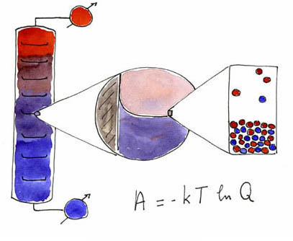
The Second Law of Thermodynamics
Valentim M B Nunes, Engineering Unit – IPTomar - Portugal

Slide 2
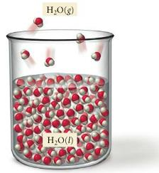
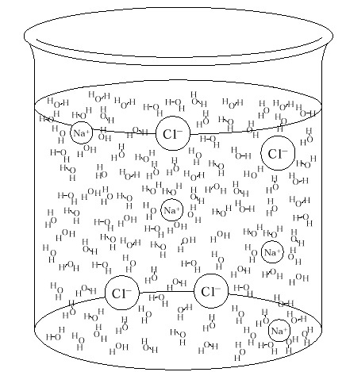
What we learn from the 1st law?
The 1st Law shows the equivalence between work and heat and told us that the internal energy of an isolated system (Universe!) is constant. However, the 1st Law tell us nothing about the spontaneous direction of an event or change!
By analogy with mechanical systems, we could think that systems evolves spontaneously to minimum energy
But this is not true!
ΔU>0

Slide 3
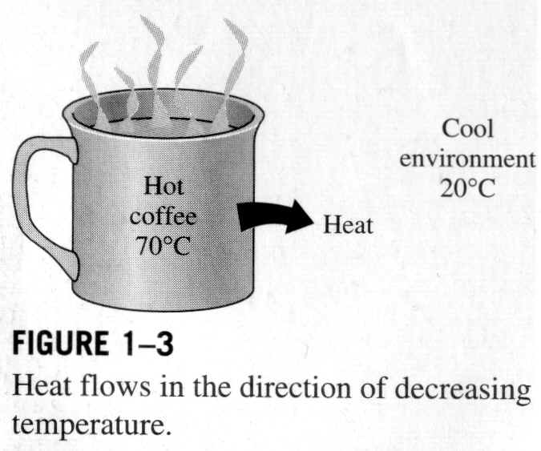
What tell us the 2nd Law
There are several asymmetry's in Nature. For instance, hot objects cool down spontaneously, but cold objects don’t’ get hotter spontaneously!
A cup of hot coffee does not get hotter and hotter in a cold room!
There must be other factors, besides U or H, that determine the spontaneous direction of any change.
The Second Law provides a set of principles for determining the direction of spontaneous change and for determining equilibrium state of a system.

Slide 4
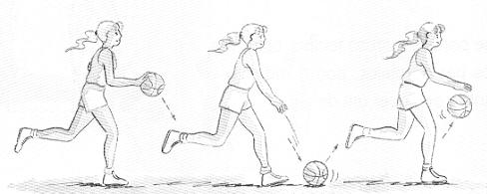
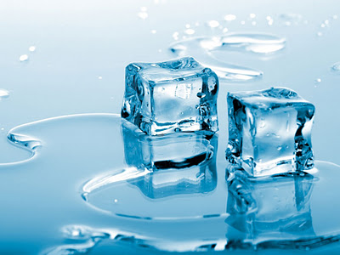
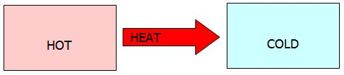
Spontaneous change; Examples
In our everyday life we are observers of many processes that are spontaneous in one direction ant not in the opposite direction.
If we stop biting the ball with will immobilize in soil. Nobody ever seen one basket ball spontaneously get higher and higher absorbing energy from the soil!
Water freezes spontaneously below 0 °C, at p = 1 atm, not the contrary!
Heat flow’s spontaneously from hot bodies to cold bodies, never the contrary!

Slide 5
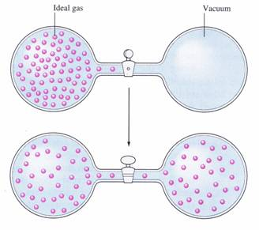
Expansion of a gas
p = 0
spontaneous
Not spontaneous
For an ideal gas at constant T, ΔU = 0; anyway there were some kind of “force” that took the gas to expand and occupy uniformly both balloons.

Slide 6
Mathematical statement
rev
We saw before, from the 1st Law, that
irrev.
As a consequence, being ΔU equal in both processes,
We now define a new state function, called ENTROPY, S, as
or
For an irreversible process, and since S is a state function
For an isolated system, Q = 0, so for any process reversible or irreversible we obtain

Slide 7
Some statements of the Second Law
Spontaneous transformations are those that can be used to produce work. When they are executed reversibly they produce maximum work. In natural or irreversible processes we never obtain maximum work.
Any spontaneous transformation produces states of higher entropy in the Universe (an isolated system!)

Slide 8
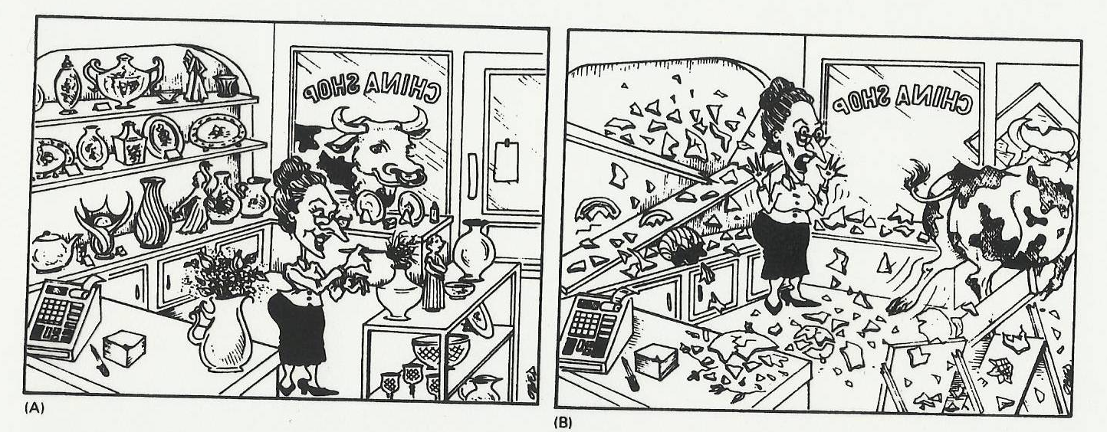
General considerations about entropy
The entropy always increase until a maximum in an isolated system. So the entropy is the direction of an event, or the “arrow of time”; it could be the physical basis of Time!
In real world, we don’t expect to find reversible systems. Current processes are irreversible. A) will happens before B); and we will never observe an inversion of time B) before A) (except in movies!)

Slide 9
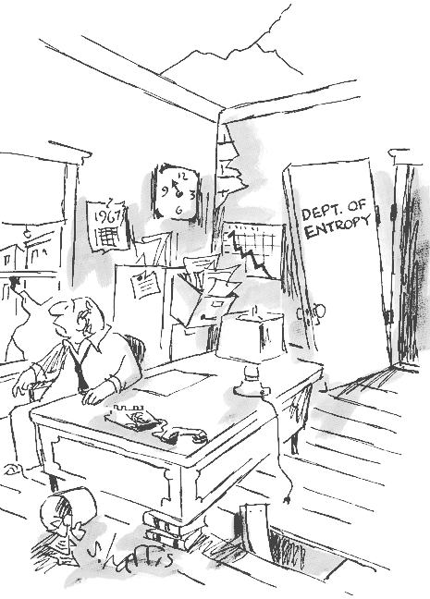
Entropy and disorder
Entropy is associated with the measure of the disorder of a system. A gas spreads spontaneously in a room! Chalk break spontaneously and no one expects that small pieces come united again spontaneously!

Slide 10

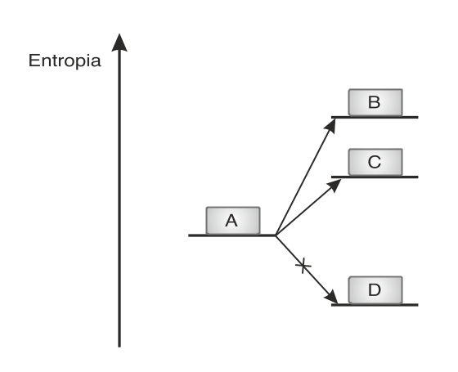
A simple game
Probability for one face of the coin = ½
With two coins:
With N coins:
If N = 100, P = 8x10⁻³¹ ~ 0
The same probability of having 100 molecules of gas in one of the balloons in slide 5!

Slide 11
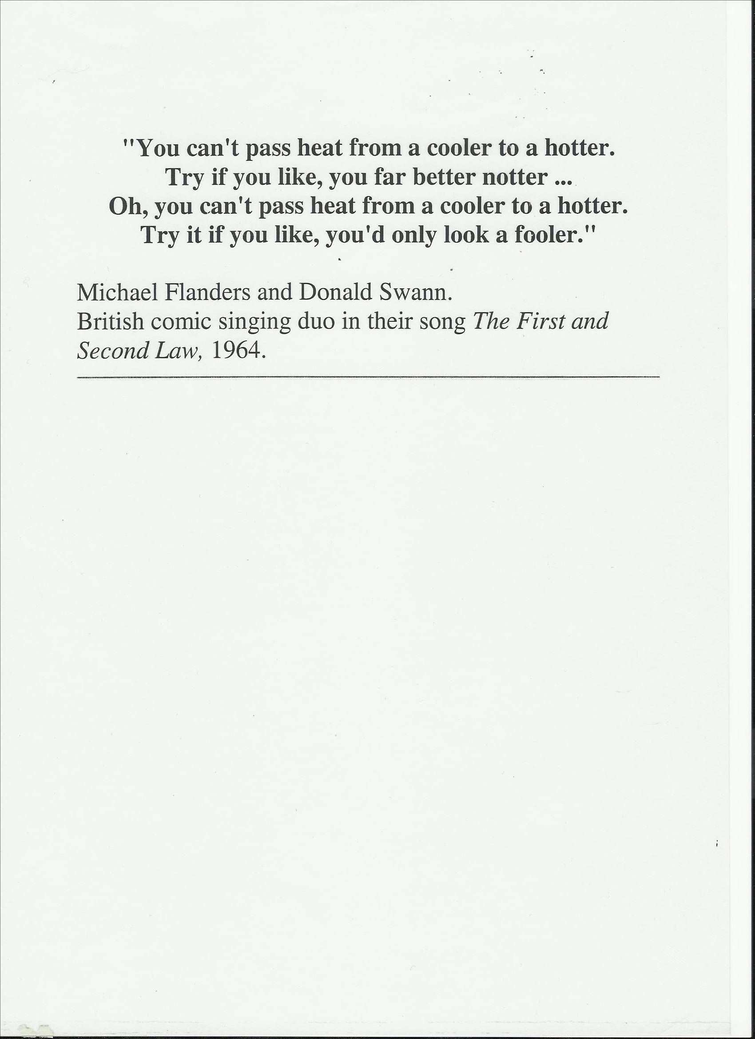
The spread of energy
The direction of spontaneous transformations is related with the spread of energy. Why a cup of coffee cannot go to ebullition by transfer of heat from a cold room? The 1st law will not be violated! Let us suppose that heat is transferred from a cold body, at temperature T_{C} to a hot body at temperature T_{H}. Then
And that is against the 2nd Law!! In fact the spontaneous process is precisely the opposite.

Slide 12
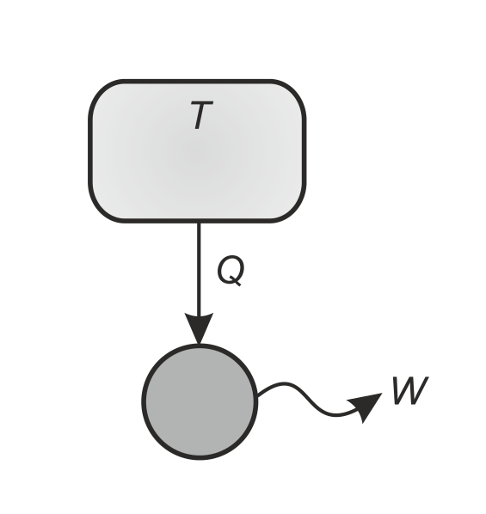
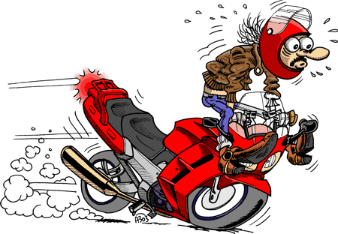
Other statements of the Second Law
The second law tell us that in the transformation of heat in work is obligatory to transfer part of the heat to a cold reservoir. That is, Nature demands a contribution when heat is converted in work, but not in the conversion of work in heat!
Kelvin statement: It is impossible for any system to operate in a cycle that takes heat from a hot reservoir and converts it completely to work

Slide 13
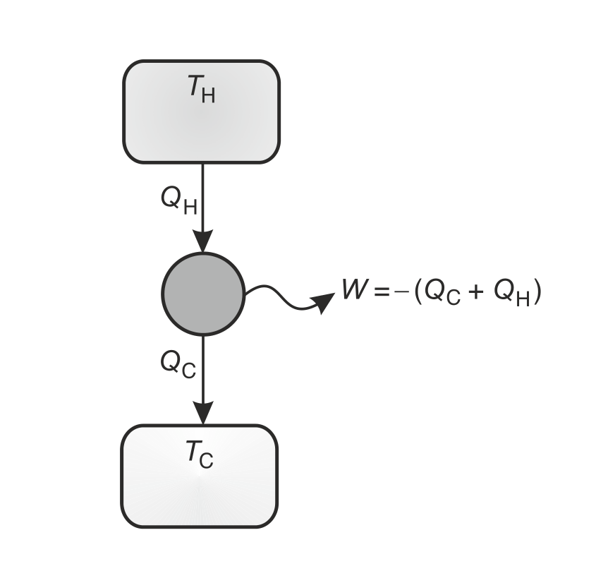
Heat Engines
Let´s assume that a certain quantity of heat is transferred from a heat reservoir at temperature T_{H} and furnished to a heat engine to do work. Part of the heat must be transferred to a cold reservoir, at temperature T_{C}
ΔS_{total} > 0, as T_{H} > T_{C}.
The heat engine works cyclically and without losses. Global change of entropy cannot be negative. So the minimum amount of heat that must be transferred to de cold sink is:
The work done by the engine when completes a cycle (ΔU = 0) its equal (in modulus) to the sum of heat imputed and heat rejected:

Slide 14
Efficiency
The thermal efficiency (or thermodynamic) of an heat engine, η, its the fraction between the work output to the surroundings, W, and the heat, Q_{H} received from the hot source
Q_{C} is negative and Q_{H} is positive!
Since the engine works cyclically :
Then the thermal efficiency of the heat engine is:
η< 1 (<100%)

Slide 15
Carnot´s Cycle
Consider an heat engine that works cyclically and without losses, doing work to the surroundings without increasing the entropy of the exterior. Working fluid is an ideal gas, and all the stages are reversible:
A→ B: Extraction of heat Q_{H} trough one isothermic and reversible expansion at temperature T_{H} from V_{A} to V_{B} (ΔU = 0)
B→ C: Adiabatic expansion from V_{B} to V_{C} with cooling from T_{H} to T_{C}
C→ D: isothermic compression at temperature T_{C} from V_{C} to V_{D}
D→ A: Adiabatic compression from V_{D} to V_{A}

Slide 16
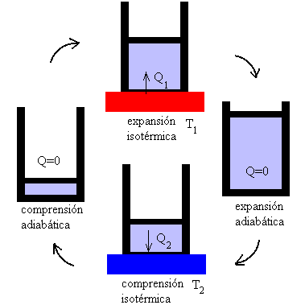
Thermal efficiency of the Carnot´s heat engine
But, in the adiabatic steps we have V_{C}/V_{D} = V_{B}/V_{A}
Then the thermal efficiency comes:
Total works is:

Slide 17
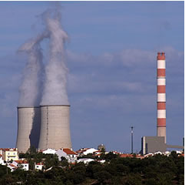
Carnot´s Principles
The second law imposes limits on the operation of cyclic devices: A heat engine cannot work through heat exchange with a single source!
We can draw two conclusions - Principles of Carnot:
The performance of an irreversible heat engine is always lower than that of a reversible heat engine that runs from the same sources (temperatures)
Efficiencies from all thermal reversible machines that run between the same two sources are equal.
The maximum thermal efficiency of a thermal power station using vapor and running between T_{H} = 750 K and T_{C} = 300 K is 60 %. Real efficiencies are around 38 – 40%.

Slide 18
Examples of ΔS calculations
Isothermic and reversible process:
But, since the system absorbs heat from the exterior or surroundings, then:
At constant p

Slide 19
Isothermal and reversible expansion of ideal gas
At constant T:
As a consequence:
In the surroundings:

Slide 20
Isothermal and irreversible expansion of ideal gas
Since the entropy is a state function, then for the gas (system)
If we consider now an expansion against an external pressure equal to p=0, then . As a consequence
and
2nd Law!

Slide 21
Heating (or cooling) at constant p (or V)
At constant p
Since dH = CpdT
If Cp is T independent, then:
At constant V we have similar equations. For instance, if C_{V} is T independent then

Slide 22
Reversible phase change at constant T and p
As an example consider the following transformation:
H₂O(l,100 ºC, 1 atm) → H₂O(g,100 ºC, 1 atm)
The heat necessary for that transformation, at constant p, is the enthalpy of vaporization, ΔH_{vap}. The entropy change is:
where T_{b} is the boiling temperature.
Generalizing for any reversible phase transition we have:

Slide 23
Trouton’s Rule
It was found, experimentally, that many liquids have a value for the entropy of vaporization that obeys the Trouton’s Rule, that is
Liquid | Δs_{vap}/J.mol⁻¹.K⁻¹
Benzene, C₆H₆ | 87,2
Carbon Tetrachloride, CCl₄ | 85,9
Hexane, C₆H₁₂ | 85,1
Water, H₂O | 109,1
Structure!

Slide 24
Absolute Entropies
The absolute entropy of a substance at temperature T can be related to the entropy at T = 0, if we know all the relevant calorimetric properties of the substance, like heat an temperature of phase transitions and heat capacities in the different phases.
These lead us to the Third Law of Thermodynamics: The entropy of every pure substance in its crystalline solid state at T = 0 is:
This was first expressed as Nernst’s Heat Theorem: At T→ 0, ΔS → 0 for all isothermal processes in condensed phases.

Slide 25
Absolute zero!
The 3rd law leads to a very important corollary: It is impossible to decrease the temperature of any system to T = 0 in a finite number of steps! In other words, the absolute zero is impossible to achieve!
Consider for instance 1 mole of ideal gas that undergoes a spontaneous process that take the system from a temperature T_{i} to a lower temperature T_{f}
But, if T_{f} = 0, the first term of equation is equal to - ∞, and the second term should be greater than + ∞, which is impossible!

Slide 26
How to calculate entropy at low temperatures!
For temperatures close to T = 0 a good equation (that can be obtained from statistical mechanics – Thermo II) is the Debye cubic equation:
Where a is a constant.
Substance at 298 K | S° (J.mol⁻¹.K⁻¹)
H₂O(l) | 69.9
H₂O(g) | 189.7
I₂(s) | 116.7
I₂(g) | 260.6
He(g) | 126.1
Ne(g) | 146.2
C_{p}/T
Liq.
Sol.
Gas
~T³
T_{fus}
T_{b}

Slide 27
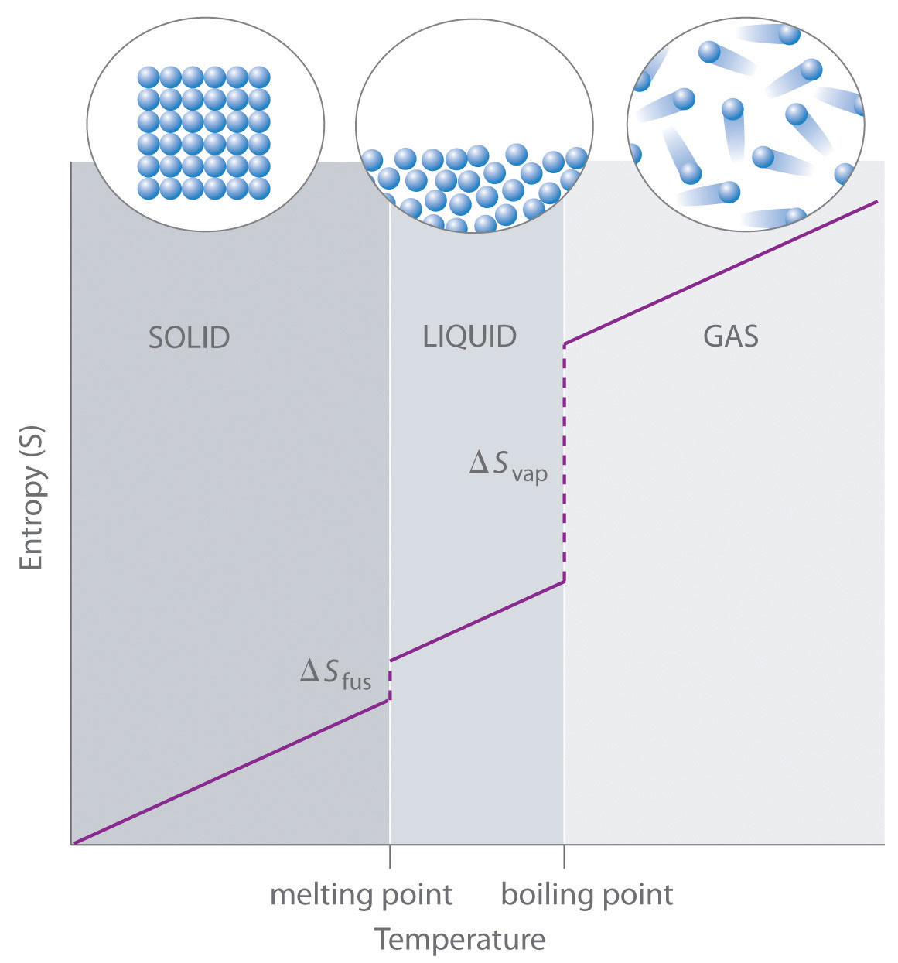
Entropy of a substance
S _{solid} < S _{liquid} << S _{gas}

