Slide 1
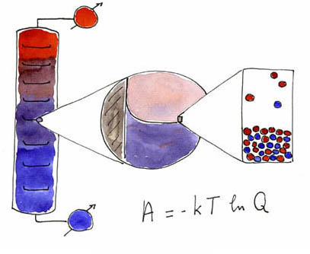
The History and the Laws of Thermodynamics
Valentim M B Nunes, Engineering Unit – IPTomar, Portugal

Slide 2
What is Thermodynamics?
Thermodynamics can be defined as the science of energy, their forms and transformations, and interaction between energy and matter. Although every body has feeling of what energy is, it is difficult to give a precise definition of it. Energy can be viewed as the ability to cause changes.
The name thermodynamics is due to the Greek words therme (heat) and dynamis (power), which is descriptive of the early efforts to convert heat into power [construction of the first successful atmospheric steam engines in England by Thomas Newcomen (1663-1729) and in Scotland by James Watt (1736-1819)]

Slide 3
Importance of the subject
As the science of energy and its effect on the material world, Chemical Thermodynamics holds one of the keys to meeting the challenges that face our modern societies and to enabling industry to propose innovative processes and to develop sustainable technologies and products.
Today Thermodynamics provides theoretical understanding extending from nano-scale molecular behaviour up to large scale planetary interactions, like environmental aspects. Its applications span a similarly large range of industrial domains (power generation, refrigeration, chemical reactions…); life sciences, with their complex molecular arrangements; nano–materials, where short range interactions are significant; complex fluids, like electrolytes and ionic fluids; critical behaviour and extraction processes (distillation…); search for new solvents; behaviour of materials under extreme condition (high temperatures, high pressures); and much more.

Slide 4
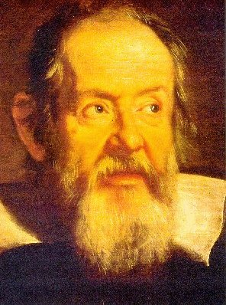
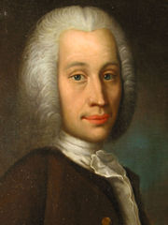
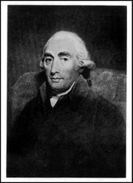
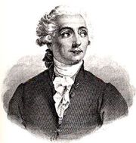
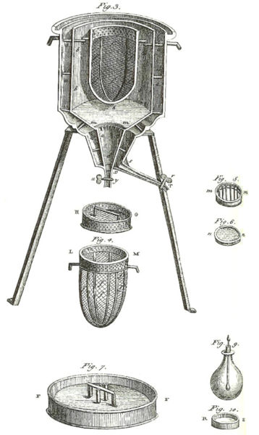
The origins
Galileu Galilei (1597-1681): Thermometry
Anders Celsius (1701-1744): scale of temperatures
Joseph Black (1728-1799)
Heat may be considered, either in respect of its quantity or of its intensity. Thus two lbs. of water, equally heated, must contain double the quantity that one of them does, though the thermometer applied to them separately, or together, stands at precisely the same point, because it requires double of time of heat two lbs. as it does to heat one.
Antoine-Laurent Lavoisier(1743-1794): calorimetry

Slide 5
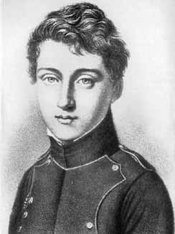
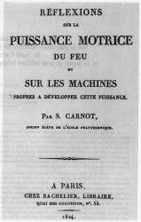
The founding “father” of thermodynamics
It is easy to see why the so-called high pressure steam engines are better than the lower ones; their advantage lies essentially in their ability to utilize a greater fall of caloric. Steam generated at a higher pressure is also at a greater temperature and as the temperature of the condenser is nearly always the same, the fall of caloric is evidently higher
Rudolf Diesel (1858-1913): Diesel engine
Sadi Carnot (1796-1832)

Slide 6
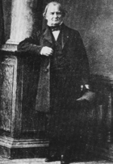
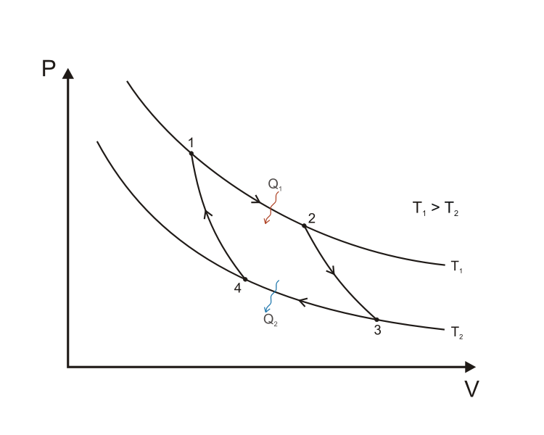
Carnot Cycle
Emile Clapeyron (1799-1864)

Slide 7
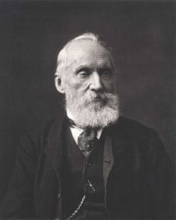
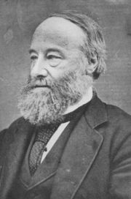
A New Science: The first law of Thermodynamics
William Thomson (or Lord Kelvin) (1824-1907) : absolute scale of temperature
Invented the word “thermodynamic” to describe the process of conversion of heat in another form of energy, mechanical work.
James Prescott Joule (1818-1889): 1st law of thermodynamics, or conservation of energy
dU = dQ + dW

Slide 8
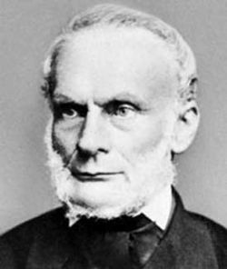
The Second Law
Rudolf Clausius (1822-1888): 2nd law of thermodynamics
Heat can never pass from a colder to a warmer body without some change , connected with it, occurring at the same time
An isolated system evolves spontaneously for a state of equilibrium that corresponds to a maximum entropy
dS>dQ/T
..schage ich vor, die Grosse S nach dem griechischen Worte η τρoπη(..) die Entropie des Korpers zu nennen (I propose to name the quantity S the entropy of the system, after the Greek word trope, the transformation.
Die Energy der Welt ist constant; die Entropy strebt einem Maximum zu
(The energy of the Universe is constant; the entropy tends towards a maximum)

Slide 9
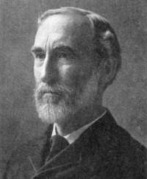
Thermodynamics AND Chemistry
Josiah Willard Gibbs (1839-1903): chemical thermodynamics
..it realized that thermodynamics could be of great value in leading to an understanding of the factors determining the direction of chemical changes.
dU = TdS-pdV
G = U+pV-TS
At constant pressure and temperature, condition for equilibrium is dG =0
(G is Gibbs energy)

Slide 10
Some quotations
[A law] is more impressive the greater the simplicity of its premises, the more different are the kinds of things it relates, and the more extended are the range of applicability. Therefore, the deep impression which classical thermodynamics made on me. It is the only physical theory of universal content, which I am convinced, that within the framework of applicability of its basic concepts will never be overthrown.
Albert Einstein, quoted in M.J. Klein, Thermodynamics in Einstein’s Universe, Science, 157, p.509 (1967)

Slide 11
Some quotations
The law that entropy always increase – the Second Law of Thermodynamics – holds I think, the supreme position among the laws of Nature. If someone points out to you that your pet theory of the Universe is in disagreement with Maxwell’s equations – then so much worse for Maxwell equations. If it is found to be contradicted by observation -- well experimentalists do bungle things sometimes. But if your theory is found to be against the second law of Thermodynamics, I can give you no hope; there is nothing for it but to collapse in deepest humiliation.
Sir Arthur Stanley Eddington, The Nature of the Physical World, Maxmillan, New York, p.74 (1948)

Slide 12
Some quotations
Thermodynamics is a funny subject. The first time you go through the subject, you don’t understand it at all. The second time you go through it, you think you understand it, except for one or two small points. The third time you go trough it, you know you don’t understand it, but by that time you are so used to the subject that it doesn’t bother you any more.
Arnold Sommerfeld

Slide 13
Further reading
Laidler, K.J., The World of Physical Chemistry, Oxford University Press, Oxford, 1995
Palavra, A.M.F., and Nieto de Castro, C.A., Termodinâmica, suas leis e história, Bol. Soc. Port. Quím., 31, 11-21 (1988)

