Slide 1




Tecnologia Química
Thermophysical Properties of Fluids Importance of Accurate Data
Valentim M.B. Nunes
April 2025

Slide 2


Slide 3
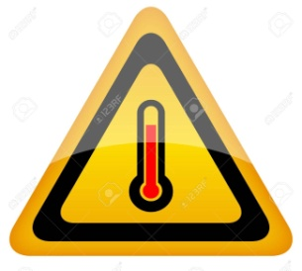
Thermophysics plays an important role in the characterization of fluids.
Thermophysical properties relevant for heat transfer and heat storage applications are the density, thermal conductivity, specific heat capacity and viscosity.
The viscosity and thermal conductivity are perhaps the most important properties on the study of liquid structure, and with industrial application.
My field, High temperatures!!!

Slide 4
Samples can react with cell walls or atmosphere giving origin to secondary reactions - purity of samples is very important
Accurate measurement of temperature is difficult
Convection and radiation contributions to heat transfer increases at high temperatures
Non-Newtonian flow can degrade results
Samples are electrically conductive

Slide 5
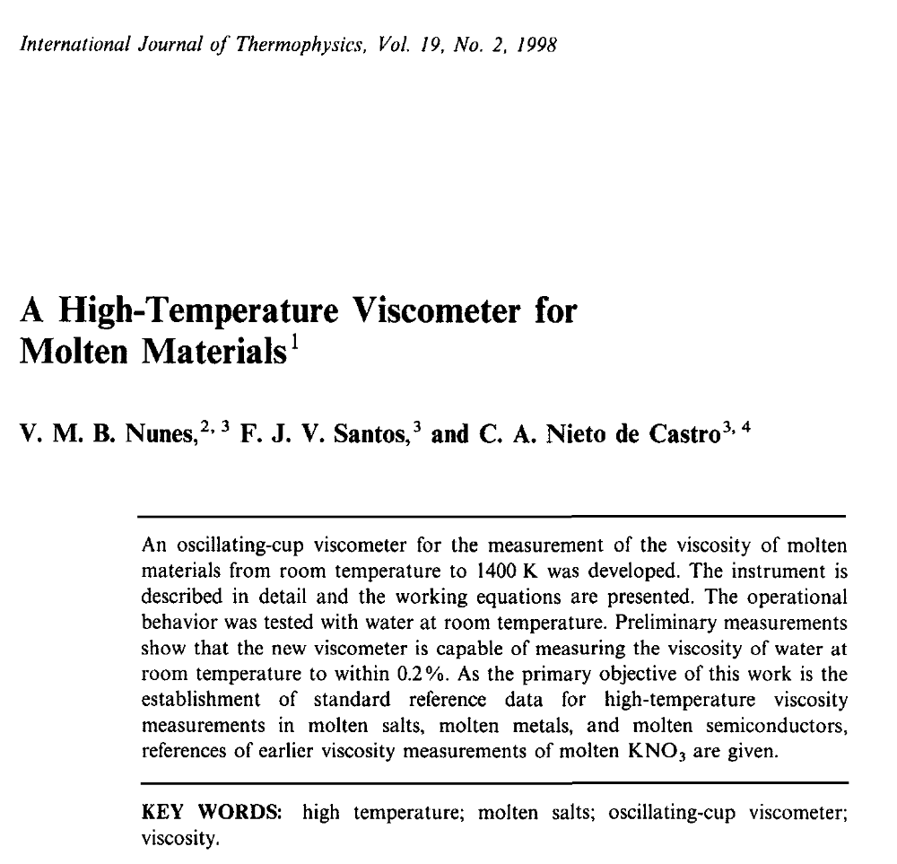

Slide 6
Photodetectors
Torsion wire
Mirror
He-Ne Laser
Time counter
Furnace
h
H
Cup containing molten material
Multimeter
Control and acquisition of data
r
Thermocouple

Slide 7
Systems studied so far:
Water - test of instrument – the only accepted standard for the viscosity of fluids
Molten salts - Sodium nitrate, potassium nitrate and lithium nitrate – Eutectic carbonates.
Molten alloys - Quasi eutectic Zn/Al alloys - Zn alloys with higher contents in aluminum and silicon - Al/Mg alloys.
Galinstan - Eutectic alloy of Gallium, Indium and Tin.

Slide 8
Molten salts constitute an important class of fluids for high temperature applications, like catalytic medium for coal gasification, molten salt oxidation of wastes and latent or sensible heat storage.
Chemical Industry
Nuclear Reactors
Molten Salts
Heat Storage/Transfer
Waste Treatment Plants
In particular, molten alkali nitrates and carbonates are being used as heat transfer/storage fluids in concentrated solar power (CSP) technologies.

Slide 9
These kind of technologies operate in ranges of temperature for which molten salts are particularly adequate, due to its main characteristics:
Liquid state in a large range of temperatures
Ability to dissolve many inorganic and organic compounds attaining high concentrations
Low vapour pressure and stability
Viscosity generally low - ions mutual independent
High heat capacity per unit volume

Slide 10
For the proper design and performance of equipment (like pumps, pipes and heat exchanger's) it is crucial to know, with the highest accuracy possible, the properties of the fluids, in special viscosity, density, thermal conductivity and specific heat capacity. These properties strongly influences pumping costs, thereby affecting production costs.
The accuracy is affected by the use of inappropriate equipment, wrong working equations and sample impurities. For instance the size of heat transfer equipment is strongly dependent on viscosity and thermal conductivity uncertainties.

Slide 11
High temperature alloys are very important in many industrial processes, like steelmaking, nonferrous metallurgy, aluminium smelting, foundry, glass manufacturing, among others
In fluid flow behaviour, kinetics of metallurgic process and die casting processes, viscosity and its reciprocal, fluidity, is a fundamental parameter

Slide 12
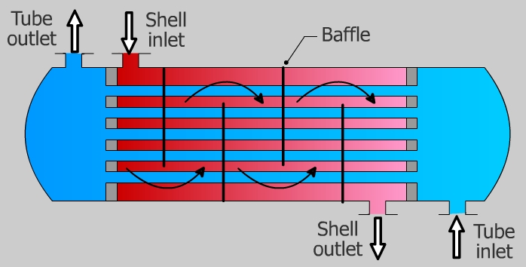
Shell and Tubes Heat Exchanger

Slide 13

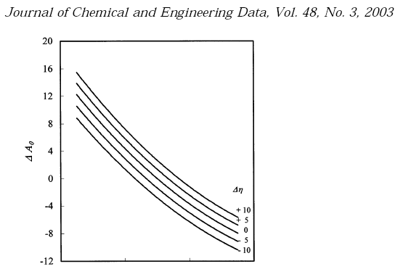
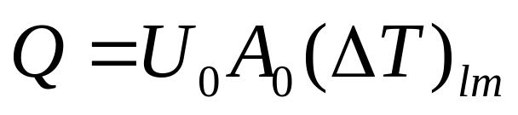
Newton´s law of cooling:
Effect of uncertainty of thermal conductivity (in %) and viscosity (in %) on the area of a shell and tubes heat exchanger

Slide 14
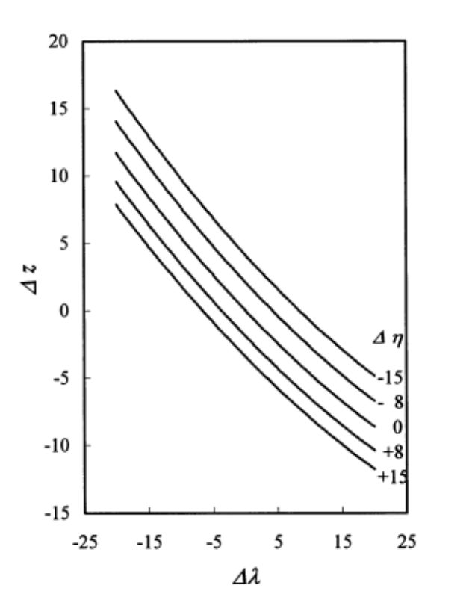
Effect of uncertainty of thermal conductivity (in %) and viscosity (in %) on the penetration distance, z, (in %) in a cold pipe [12]

Slide 15
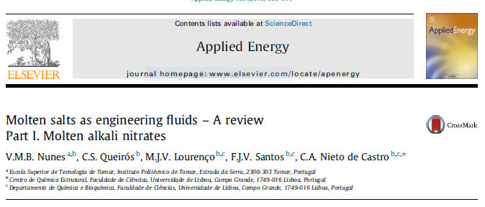

Slide 16
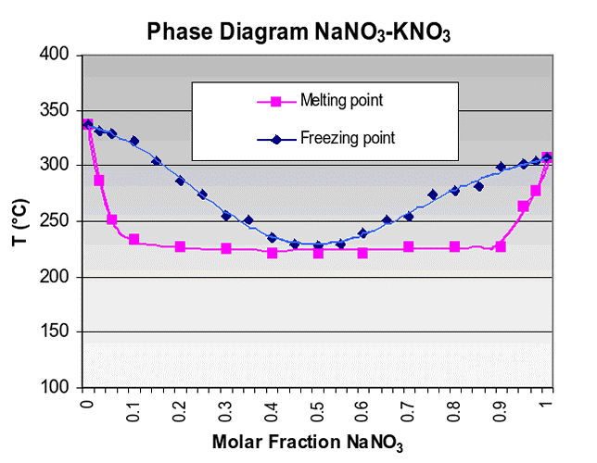
http://www.archimedesolarenergy.it/molten_salt.htm

Slide 17
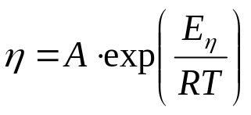
?
?

Slide 18
Hitec

Slide 19
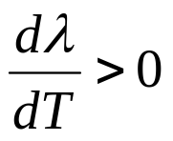
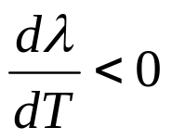
KNO₃

Slide 20
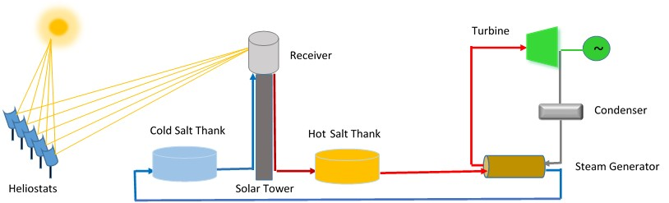
Pipes
Heat Exchangers

Slide 21
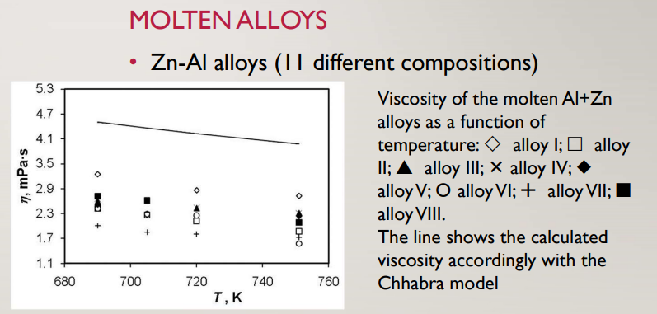

21

Slide 22
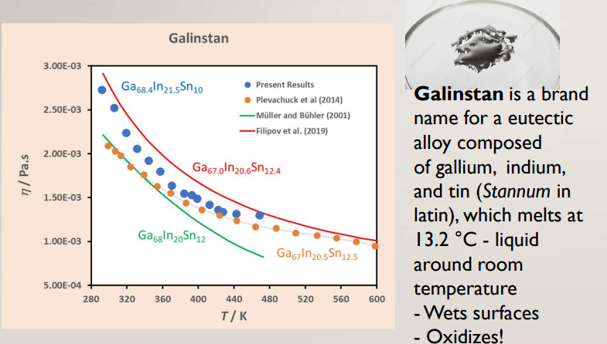

Slide 23

https://webbook.nist.gov/chemistry/fluid

